Slide 1
Java vs Python
characteristics, use cases, and advantages.

Slide 2
What is Python?
Python is a high-level, interpreted, object-oriented programming language with dynamic semantics created by Guido van Rossum. Originally released in 1991, Python is a dynamically typed and garbage-collected language designed to be highly readable.

Slide 3
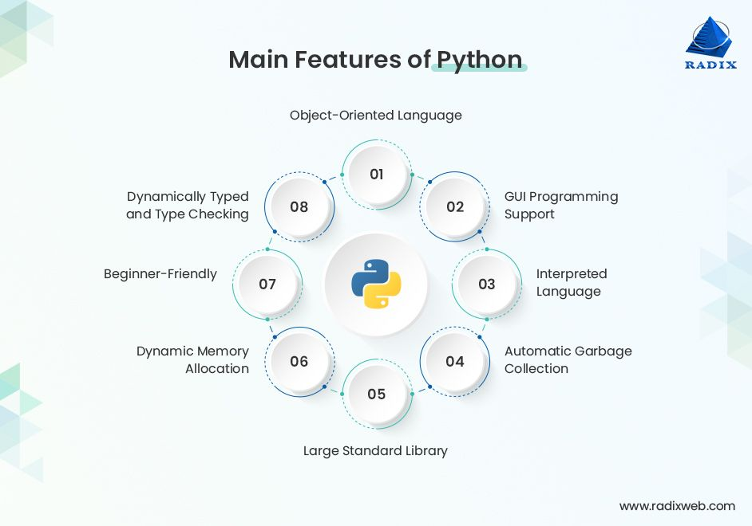
Features of Python
Following are some of the main features of Python programming language:

Slide 4
Advantages of Python
By leveraging Python ecosystems and Python frameworks, you can get the following advantages:
A Pool of Third-party Modules
Open Source and Large Active Community Base
User-friendly Data Structures
Dynamically Typed
Portability
Versatile - Easy to Read, Learn and Write

Slide 5
Disadvantages of Python
Even Python has some limitations, which are:
Slow Speed
Memory Intensive
Weak In Mobile Computing
Runtime Errors
Not Optimized for Database Access
No Multithreading Support

Slide 6
When to Use Python?
Python is used for web development and software development, task automation, data visualization, and data analysis. Since Python is easy to learn and write, it has been adopted by many beginners and non-programmers like scientists and accountants to perform data management tasks.
Python is used for:
Data Analysis, Data Visualization and Machine Learning
Python for Software Development and Web Development
Automation or Scripting
Software Testing and Prototyping

Slide 7
What is Java?
Java is a high-level, class-based, object-oriented programming language for developing web applications.
Java is a general-purpose programming language developed by Sun Microsoft, allowing Java developers to follow one concept - write once, run anywhere. Java has evolved as a programming language with time, from simple text pages to pages with video and animation.

Slide 8
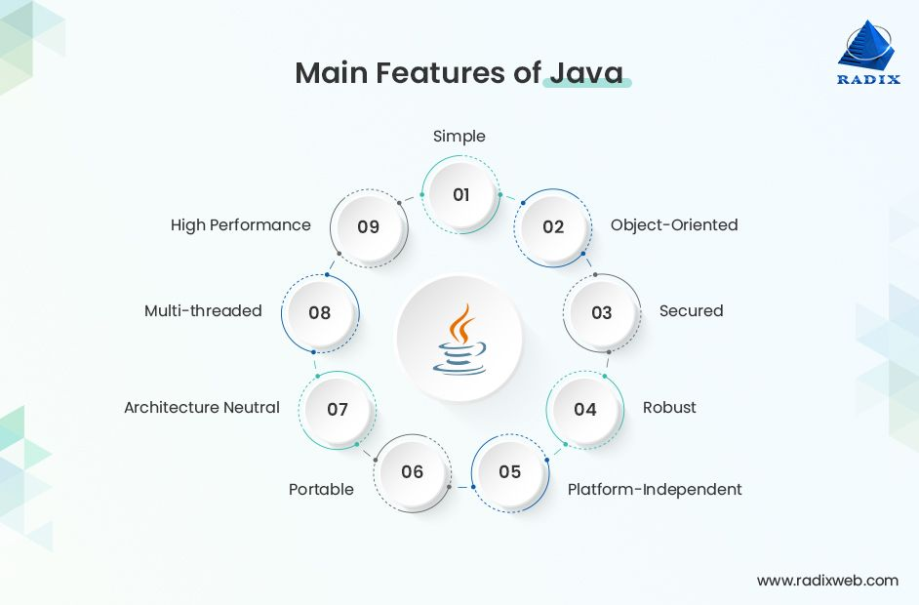
Features of Java
The prime features of Java programming language are as follows:

Slide 9
Advantages of Java
There are a large number of applications in the world which use Java. Also, many organizations have opted for Java development to advance their competence in the market. However, by utilizing top Java frameworks, you can get the most out of this programming language.
Benefits of Java are:
Simple and Easy to Learn
Object-Oriented
Low-Security Risks
Automates Memory Process
Supports Functional Programming

Slide 10
Disadvantages of Java
Let’s understand Java disadvantages:
Performance
Memory Consumption
Cost
Less Machine Interactive

Slide 11
When to Use Java?
Since Java is an open-source, versatile language, it’s used to build localized and distributed software, including:
Game Development
Cloud Computing
Big Data
Artificial Intelligence
IoT Applications
Chatbots and Other Marketing Tools

Slide 12
CONCLUSION
We can conclude that both Python and Java languages have their strengths and weaknesses. The choice completely depends on your project requirements, your familiarity with the languages, and the ecosystem you intend to work within.
When considering Java vs Python, Java is quick and more portable, whereas Python is simple and concise. We can say that the future of Python is very glaring and assertive.
While Python may not be flawless, if we look at its future and consider it as its emerging language, it's important to acknowledge that Java holds the present ground with its extensively utilized APIs.

